Slide 1
נושאים במערכות מידע ושפות תכנות
Todo-app
נגה זקס, יאיר זדרמן

Slide 2
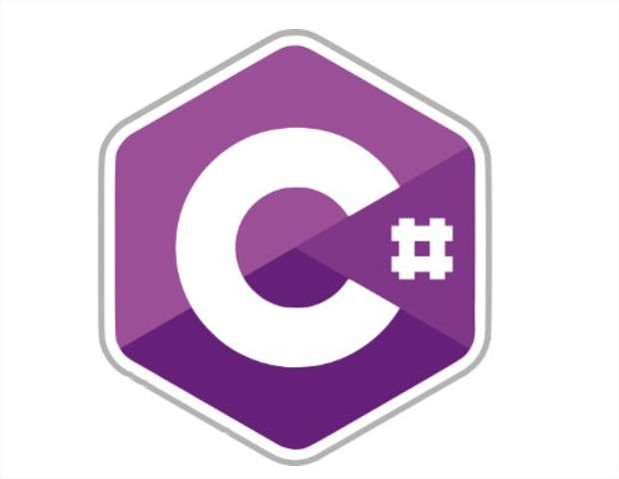
C# is a modern multi-paradigm programming language – it can be object oriented, functional, procedural etc.
Type-safe language with static types, including auto memory-management. In addition, it’s syntax resembles C++ and Java
C# was designed by Microsoft in 2000, and according to StackOverflow’s survey in 2019, 31.9% of professional developers prefer C# as their main programming language..

Slide 3

.NET framework is the most popular web-framework for C#, designed by Microsoft.
.NET Framework is used to create and run software applications. .NET apps can run on many operating systems, using different implementations of .NET, while having one consistent API.
.NET is open source, and it’s community has over 5,000,000 developers which support and contribute to it.
.NET is a very fast framework. It provides better response time and require less compute power than most of other solutions.

Slide 4

We stored the data in a SQLite database, an embedded database written in C language.
Our data is stored in 2 tables (“models”) – “people” and “tasks”.
The table “people” contains data about the task owners, while “tasks” contains data about the tasks in the system – tables are related using “ownerId” field.
We chose this specific storage because it has great support in C#. It is fast, reliable and accessible. In addition, it has integrated checking for values in the table (i.e – task status is checked directly in the DB

Slide 5
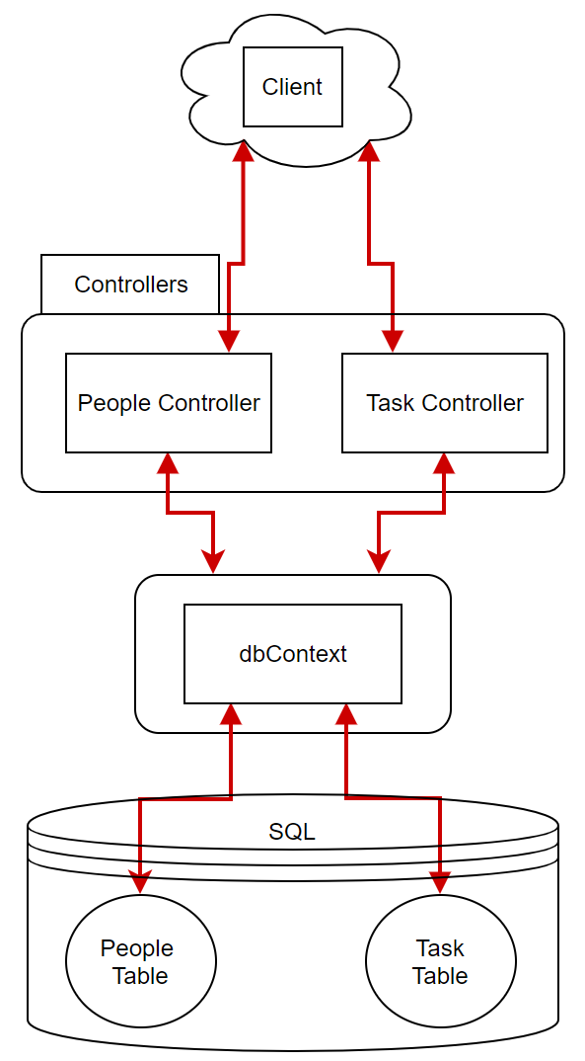
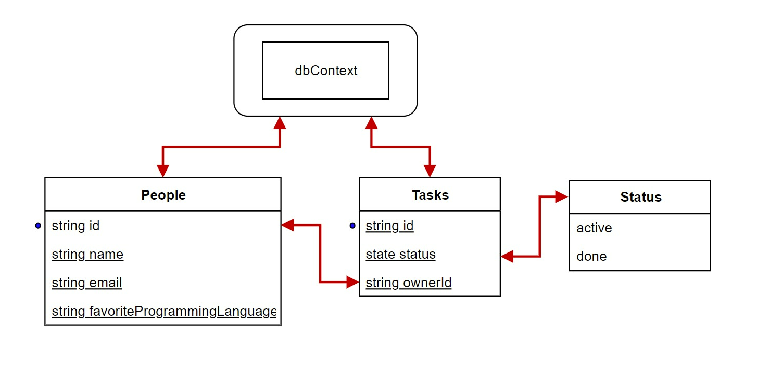
Notes:
Our system contains 2 main components – models and controllers. Each class in models represents a table in our database, and each controller contains the relevant actions for the different requests that are related to the corresponding model. The access to the DB is using the “context” model which holds the current stored data.
After defining the models, the framework generates a skeleton for the corresponding controller with basic functions implementations, such as “post”, “get”, “delete”.
We needed to change the generated functions in the controllers to fit the API’s requirements (add headers, check email address in “post” requests, update relevant data in database when deleting task/people).
We added the more “complex” functions, such as “api/people/{id}/tasks” which requires getting data from both of the tables we used.

